Slide 1


MAR BASELIOS INSTITUTE OF TECHNOLOGY AND SCIENCE
NELLIMATTOM, KOTHAMANGALAM
DEPARTMENT
OF
COMPUTER SCIENCE AND ENGINEERING
A Holistic Approach on Airfare Price Prediction Using Machine Learning Techniques
Project Guide
Dr.Suji Pramila R
Associate professor,
Dept. of CSE
Submitted By
Group No:13
Aadhil Muhammed K K (MBI20CS001)
Alan Sha (MBI20CS006)
Sojan P Renny (MBI20CS054)

Slide 2
Abstract
Introduction
Objectives
Literature Survey
Drawbacks of Existing System
Proposed System
Software and Hardware Requirements
Architecture
Module Specification
Workplan
Conclusion
References
CONTENTS

Slide 3
ABSTRACT
Globalization necessitates the implementation of pricing strategies, especially in industries like airlines, where companies must navigate diverse international markets.
Airlines employ dynamic pricing strategies, frequently adjusting ticket prices based on a combination of proprietary rules and sophisticated algorithms to respond to market demand and competition.
Artificial Intelligence (AI) models play a crucial role in the airline industry by enabling the efficient and adaptable determination of pricing policies. These models leverage advanced algorithms to analyze various factors affecting ticket costs.

Slide 4
INTRODUCTION
Importance of price prediction due to dynamic pricingNeed for sophisticated AI techniques for faster adaptation.
Objectives: Holistic analysis, similarity among airlines, models performance comparison
Airlines changing ticket prices often based on proprietary algorithms

Slide 5
OBJECTIVES
Compare airfare policies.
Find affordable ticket costs.
Analyze airfare prices.
Predict and evaluate with AI models.

Slide 6
LITERATURE SURVEY
1. A Framework for Airfare Price Prediction: “A Machine Learning Approach
Predicts plane ticket costs for various flights.
Uses data from Airline Origin and Destination Survey, Air Carrier Statistics, and economic data.
Applies machine learning methods like linear regression, decision trees, random forests, and gradient boosting.
Achieves high accuracy with a score of 0.869 on testing.

Slide 7
LITERATURE SURVEY
Requires frequent updates to reflect market changes and evolving data.
ADVANTAGES
Relies on easily accessible and reliable public data sources.
Combines various data sources to capture complex factors.
Utilizes machine learning for high prediction accuracy.
DISADVANTAGES
Spiking neural networks demand specialized hardware.
They often have lower performance than traditional neural networks.
Sensitivity to input changes can impact generalization and robustness.

Slide 8
LITERATURE SURVEY
2. To Wait or To Buy: A Recommendation Service for Airline Ticket Purchase Timing Predicts plane ticket costs for various flights.
Introduces service for optimal airline ticket timing.
Gathers data from online travel agency: flight details, price history, seat availability.
Utilizes PACES strategy for risk and benefit evaluation.
Compares PACES with other strategies using metrics like success rate, cost, and savings.
Concludes PACES is significantly superior in real-world scenarios.

Slide 9
LITERATURE SURVEY
Requires frequent updates to reflect market changes and evolving data.
ADVANTAGES
Considers risks like price changes, seat availability, and demand fluctuations.
Adapts to changes by updating parameters and weights.
Improves efficiency through clustering and feature selection.
DISADVANTAGES
May miss user preferences or external factors.
Data errors possible (incomplete or inaccurate)
Risks over/underestimating costs due to model assumptions.

Slide 10
LITERATURE SURVEY
3. Flight Ticket Prediction Using Gradient Boosting Regressor Compared With Linear Regression Predicts plane ticket costs for various flights.
Predicts ticket prices using Gradient Boosting Regression, comparing with Linear Regression.
Tests on two groups of 10 samples from data of two airlines.
Gradient Boosting: 82.5% accuracy; Linear Regression: 62.5%.
Significant difference (p<0.05) in a two-tailed test.
Concludes Gradient Boosting is more effective for ticket prediction

Slide 11
LITERATURE SURVEY
Requires frequent updates to reflect market changes and evolving data.
ADVANTAGES
Relies on easily accessible and reliable public data sources.
Combines various data sources to capture complex factors.
Utilizes machine learning for high prediction accuracy.
DISADVANTAGES
May overlook competition and demand changes.
Potential errors or biases, including missing or incorrect information.
Risk of focusing too much or too little on certain details.
Requires frequent updates to stay relevant as industry conditions change.

Slide 12
LITERATURE SURVEY
4. Prediction of Flight Fare using Deep Learning TechniquesPredicts plane ticket costs for various flights.
Uses deep learning for flight fare prediction with Indian airline data.
Analyzes factors affecting price fluctuation, providing insights.
Employs visualizations (correlation matrix, boxplot, bar chart, line plot) for dataset exploration.
Claims highest accuracy with random forest and gradient boost techniques.

Slide 13
LITERATURE SURVEY
Requires frequent updates to reflect market changes and evolving data.
ADVANTAGES
Applies deep learning for Indian airline fare prediction.
Analyzes factors like Covid-19 impact, seasonality, demand, and pricing discrimination.
Uses visualizations for dataset exploration and feature understanding.
Claims highest accuracy with random forest and gradient boost techniques.
DISADVANTAGES
Omits comparison with existing methods for fare prediction.
Lacks details on deep learning model design and evaluation.
Ignores ethical implications of machine learning in price prediction.

Slide 14
LITERATURE SURVEY
5. ACER: An adaptive context-aware ensemble regression model for airfare price prediction Predicts plane ticket costs for various flights.
Introduces ACER for predicting lowest flight ticket prices.
Utilizes clustering and modeling for regression with different contexts
Dynamically adjusts context features for improved accuracy and efficiency
Evaluates ACER on real flight data, outperforming other models.

Slide 15
LITERATURE SURVEY
Requires frequent updates to reflect market changes and evolving data.
ADVANTAGES
Captures context-specific patterns and trends in flight prices.
Automatically adjusts to changing data and situations.
Reduces model complexity and computation costs.
Enhances prediction accuracy and reliability.
DISADVANTAGES
May struggle with unexpected events impacting flight prices.
Could introduce errors or biases during data partitioning and feature selection.
Risks losing information or consistency in dynamic adjustment processes.

Slide 16
LITERATURE SURVEY
6. Progressive Tandem Learning for Pattern Recognition With Deep Spiking Neural Networks
Introduces MS-SSA-LSTM for stock price prediction.
Combines sentiment analysis, swarm intelligence, and deep learning.
Uses East Money forum data for sentiment index and SSA for LSTM hyperparameter optimization.
Outperforms other models, showing a 10.74% improvement in R2 and high universal applicability.

Slide 17
LITERATURE SURVEY
Requires frequent updates to reflect market changes and evolving data.
ADVANTAGES
MS-SSA-LSTM combines multi-source data, sentiment analysis, swarm intelligence, and deep learning.
SSA optimizes LSTM hyperparameters for improved prediction.
Adding sentiment index enhances MS-SSA-LSTM's predictive performance.
DISADVANTAGES
Spiking neural networks demand specialized hardware.
They often have lower performance than traditional neural networks.
Sensitivity to input changes can impact generalization and robustness.

Slide 18
LITERATURE SURVEY
7. A Stock Price Prediction Model Based on Investor Sentiment and Optimized Deep Learning
Proposes stock price prediction with sentiment and optimized deep learning.
Uses sentiment analysis from online sources.
Applies deep learning for complex stock price patterns.
Optimizes with genetic algorithm for better accuracy and stability..

Slide 19
LITERATURE SURVEY
Requires frequent updates to reflect market changes and evolving data.
ADVANTAGES
Answers user queries about images.
Generates concise, coherent, and accurate descriptions of images.
Transcribes text from images verbatim, with exceptions for length or offensiveness
DISADVANTAGES
Relies on sentiment analysis, potentially not reflecting all investor opinions.
Uses Sparrow Search Algorithm for LSTM optimization, sensitive to initial settings.
More suitable for short-term prediction in the Chinese market, may not perform well long-term or in different markets.

Slide 20
LITERATURE SURVEY
8. Research on Multi-Characteristic Enterprise Product Intelligent Pricing Method Based on GSADF-TOPSIS-BP Model
Introduces a new pricing method for multi-characteristic enterprise products.
Utilizes GSADF-TOPSIS-BP model, combining GSADF, TOPSIS, and BPNN techniques.
Accurately reflects product value by considering features, market demand, and customer preference.
Applies method in a case study, comparing it with traditional pricing approaches.

Slide 21
LITERATURE SURVEY
Requires frequent updates to reflect market changes and evolving data.
ADVANTAGES
Provides a rational and scientific pricing method for multi-characteristic products.
Enhances market competitiveness and profitability through adaptable pricing.
Minimizes pricing errors and risks linked to human factors or subjective judgments.
DISADVANTAGES
GSADF-TOPSIS-BP model uses GSADF, TOPSIS, and BPNN techniques.
GSADF limitations: requires large samples, sensitive to noise, struggles with complex dynamics.
TOPSIS drawbacks: subjective weight assignment, unrealistic criteria assumptions, challenges with data uncertainty.

Slide 22
LITERATURE SURVEY
9.PADaaV: Blockchain-Based Parking Price Prediction Scheme for Sustainable Traffic Management
Proposes PADAaV, a blockchain-based parking price prediction scheme.
Aims to improve traffic management, reduce congestion, and minimize pollution.
Utilizes smart contract for parking data collection and deep neural network for price prediction.
Provides incentives for driver participation and data sharing.
Evaluates performance and security through simulations and experiments.

Slide 23
LITERATURE SURVEY
Requires frequent updates to reflect market changes and evolving data.
ADVANTAGES
Reduces congestion by adjusting parking prices based on demand.
Ensures security and transparency using blockchain and smart contracts.
Encourages driver participation and data sharing for better predictions.
DISADVANTAGES
Requires high trust and cooperation among participants.
May face scalability and performance issues.
Incurs potential high transaction costs and energy consumption..

Slide 24
LITERATURE SURVEY
10. Deep Learning Model for House Price Prediction Using Heterogeneous Data Analysis Along With Joint Self-Attention Mechanism.
Introduces an end-to-end joint self-attention model for house price prediction using varied data.
Applies attention mechanisms to identify crucial features affecting house prices.
Considers interactions between different features to capture complex relationships. Experimentally shows low prediction error, outperforming other models in Taipei and New Taipei City.

Slide 25
LITERATURE SURVEY
Requires frequent updates to reflect market changes and evolving data.
ADVANTAGES
Uses diverse data for accurate house price prediction.
Applies spatial transformer network for effective satellite map feature extraction.
Employs joint self-attention to identify crucial features and interactions.
DISADVANTAGES
Relies on accurate and complete web page context.
Limited by predefined tools and prompt rules.
May struggle with subjective or complex questions.

Slide 26
DRAWBACKS OF EXISTING SYSTEM
Ignores airfare changes.
Doesn't assist in booking.
Limited in scope.
Doesn't compare with other methods

Slide 27
PROPOSED SYSTEM
Methodology:A two step methodology was adopted. The first step involved selecting initial machine learning models for evaluation. In the second step, these initial models were extended to the quantum domain for comparisons.
Datasets:Flight data for multiple destinations and airlines were collected from various sources.
Features:Key features describing flight details like class, departure time, stops etc. were extracted.
Models:Models from machine learning, deep learning and quantum machine learning domains were chosen for analysis.
Dataset source:The flight dataset was made available through an online repository.

Slide 28
SOFTWARE REQUIREMENTS
Tool: Python IDLE, Visual Studio Code, Anaconda
Python: version3
Operating System: Windows 10

Slide 29
HARDWARE REQUIREMENTS
Processor: i5 or i7
RAM: 8 GB (Minimum)
Hard Disk: 500GB SSD or above
Mouse
Keyboard

Slide 30
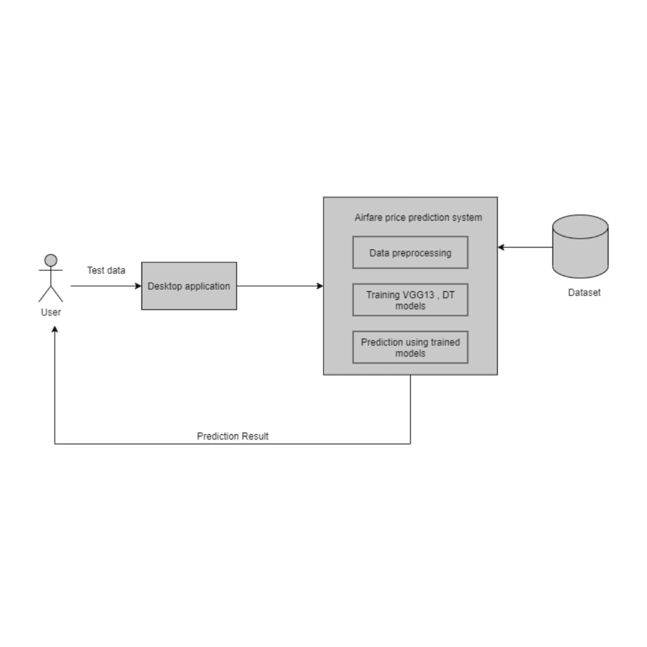
ARCHITECTURE

Slide 31
MODULE SPECIFICATION
Data Preprocessing:
Loading dataset
Handling Missing values
Train Test Split
VGG13
Decision Tree
Prediction
Prediction using the model
View result (price)

Slide 32
WORKPLAN
Work to be done | Done by | By When
Model Development | Aadhil Muhammed K K Alan Sha Sojan P Renny | January 2024
Visualization Framework and Integration | Aadhil Muhammed K K Alan Sha Sojan P Renny | February 2024
Testing and Evaluation | Aadhil Muhammed K K Alan Sha Sojan P Renny | March 2024
Documentation and Deployment | Aadhil Muhammed K K Alan Sha Sojan P Renny | March 2024

Slide 33
CONCLUSION
QML models demonstrated potential for efficient airfare price prediction, especially as data complexity and diversity increase.
Future work includes investigating various data encoding methods in quantum statesand exploring more quantum models like quantum Boltzmann machines.
QML-based applications could serve as airfare price policy generators

Slide 34
References
- T. Kalampokas, K. Tziridis, N. Kalampokas, A. Nikolaou and G. Kostopoulos, "A Holistic Approach on Airfare Price Prediction Using Machine Learning Techniques," in IEEE Access, vol. 11, pp. 46627-46643, 2023, doi: 10.1109/ACCESS.2023.3274669
T. Wang, S. Pouyanfar, H. Tian, Y. Tao, M. Alonso Jr., S. Luis and S. Chen, "A Framework for Airfare Price Prediction: A Machine Learning Approach," 2019 IEEE 20th International Conference on Information Reuse and Integration for Data Science (IRI), Los Angeles, CA, USA, 2019, pp. 1-8, doi: 10.1109/IRI.2019.0004
T. Wang, S. Pouyanfar, H. Tian, Y. Tao, M. Alonso Jr., S. Luis and S. Chen, "A Framework for Airfare Price Prediction: A Machine Learning Approach," 2019 IEEE 20th International Conference on Information Reuse and Integration for Data Science (IRI), Los Angeles, CA, USA, 2019, pp. 1-8, doi: 10.1109/IRI.2019.00041.

Slide 35
References
T. Kalampokas, K. Tziridis and G. Kostopoulos, "Airfare prices prediction using machine learning techniques," 2017 25th European Signal Processing Conference (EUSIPCO), Kos, 2017, pp. 1038-1042, doi: 10.23919/EUSIPCO.2017.8081365.²
S. Pouyanfar et al., "Machine Learning-Based Approach for Airfare Forecasting," in Advances in Intelligent Systems and Computing, vol. 1330, pp. 839-849, Springer, Singapore, 2023.
H. Tian et al., "A Framework for Airfare Price Prediction: A Machine Learning Approach," 2019 IEEE 20th International Conference on Information Reuse and Integration for Data Science (IRI), Los Angeles, CA, USA, 2019, pp. 1-8, doi: 10.1109/IRI.2019.00041.
] D. Reebadiya, R. Gupta, A. Kumari, and S. Tanwar, ‘‘Blockchain and AIintegrated vehicle-based dynamic parking pricing scheme,’’ in Proc. IEEE Int. Conf. Commun. Workshops (ICC Workshops), Jun. 2021, pp. 1–6

Slide 36
References
W. Zeng, ‘‘Research on the relationship between enterprise product innovation ability, product innovation, and process innovation mode,’’ Bus. Admin., Huazhong Univ. Sci. Technol., Wuhan, China, Jul. 2012.
W. Xiong et al., “Toward human parity in conversational speech recognition,” IEEE/ACM Trans. Audio Speech Lang. Process., vol. 25, no. 12, pp. 2410–2423, Dec. 2017.
M. M. Rounaghi and F. N. Zadeh, ‘‘Investigation of market efficiency and financial stability between S&P 500 and London stock exchange: Monthly and yearly forecasting of time series stock returns using ARMA model,’’ Phys. A, Stat. Mech. Appl., vol. 456, pp. 10–21, Aug. 2016, doi: 10.1016/j.physa.2016.03.006.

Slide 37
THANK YOU

